Slide 1

Byte Mechanics
Sprint 1 Presentation
Abby Rictor, Aislinn Jeske (Scrum Master), Farzaneh Elyaderani, Marylou Nash, Zachary Klausner

Slide 2
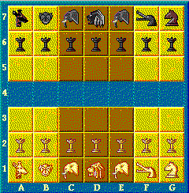
Game: Congo
Congo is played on a 7*7 board
Pieces include pawns and several animals
Designed for two players
Middle row of board is river
Has two 3*3 castles to house lions
Usually game starts with “White” group
Pieces can “move”, “jump” and “capture”
Game ends when a “lion” is captured
“Winner” is the player who captures the lion
Notes:
Kinda chess game, designed on 7*7 board. Like chess, designed for two players , each player owns different piece.
Every single piece has a specific rules to identify legal moves.

Slide 3
User Stories and Tasks
Epic: User Capabilities
User can register/create an account
- User enters an email - User enters a username - Check if username and email are unique - User enters a password - User info added/stored in the database - A profile will be created for user
User can login to his profile
- User log into his profile - User can see other player’s profile - User can see his games’ list (finished games, abandoned games) - User can see his games’ history (the players, start / end times and date)
User can start a new match
- User choose a game to start - User see the list of other players - User choose a partner to play ( by sending invitation) - players log into the new game - Game starts with having at least 2 players
User can invite a friend to play
- User can invite a friend / friends to play - User sends email/ notification for invitation
User can accept the game invitation
- User accept the invitation - User log into the game screen
Notes:
We start our design by identifying all possible stories from the user perspective with their priority in the first sprint meeting. We identified an general epic called user capabilities , and list all possible stories with all corresponding tasks that a user expect …

Slide 4
User Stories and Tasks
Epic: User Capabilities
User can search for a game
- User can search for a new game - User can search for his abandoned games to resume - User can search to see/track his finished games
User can leave current game
- Game should be flagged as “ abandoned game” - The status of game need to be stored for the next time
User can reject the game invitation
- User rejects the invitation - User still able to see other invitations
User can make a move on current game
- User can make a valid move on his ongoing game
User can unregister an account
- Remove user’s information from database
User can view games’ status
- User can see the status of ongoing games - User can see the status of his games (finished, unfinished) on his profile
Notes:
Registration to platform
- Create a bare bone registration screen
- Create user’s fields ( email, username and password and register/ login button)

Slide 5
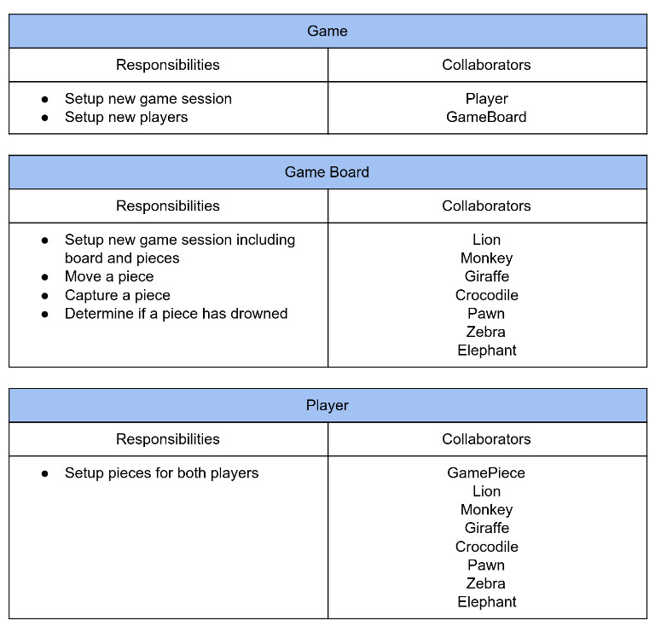
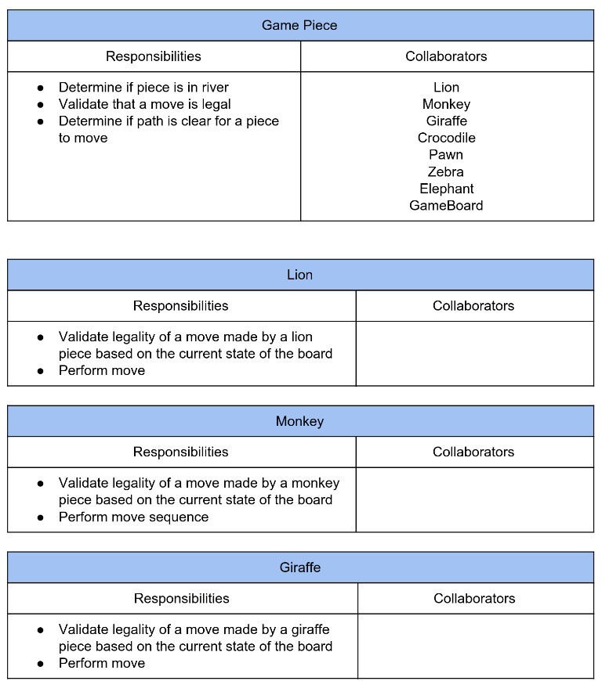
CRC Cards

Slide 6
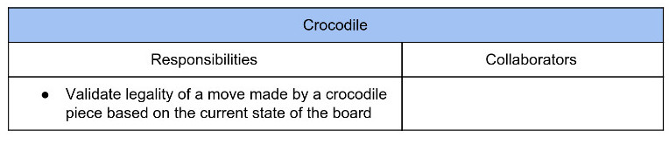
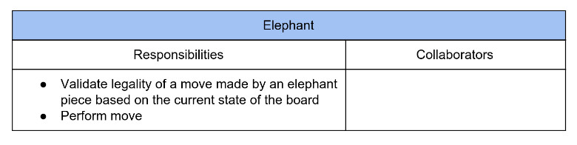
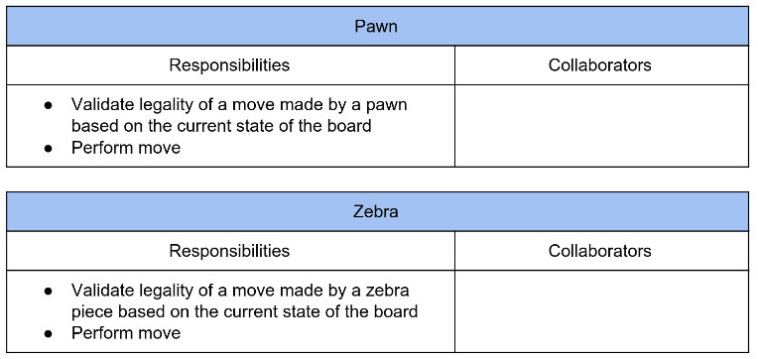

Slide 7
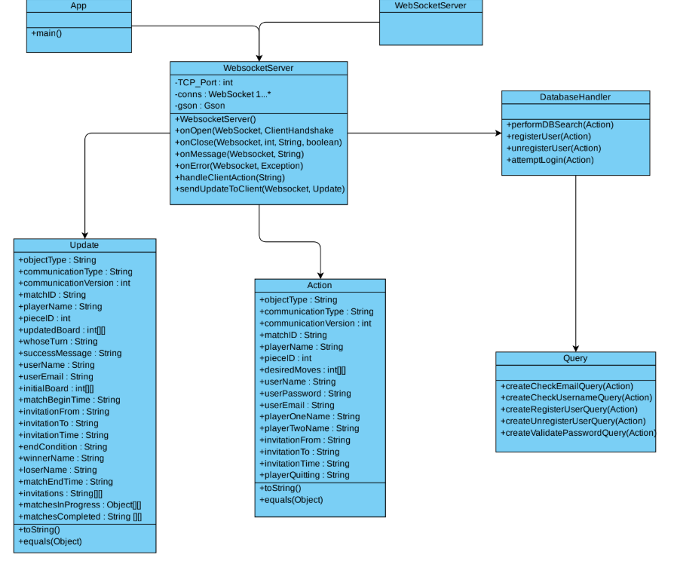
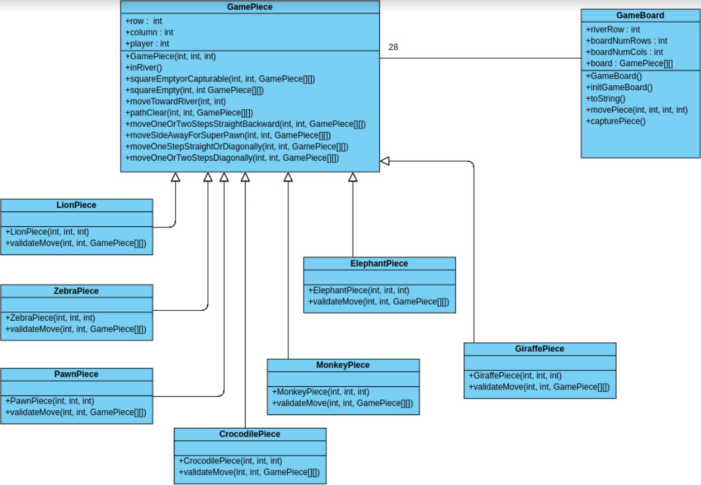
Class Diagram

Slide 8
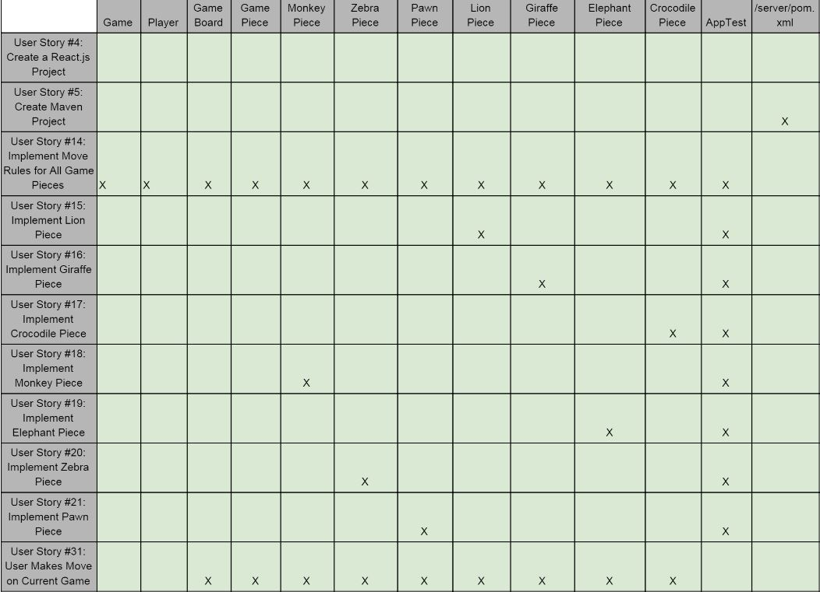
Traceability Link Matrix

Slide 9
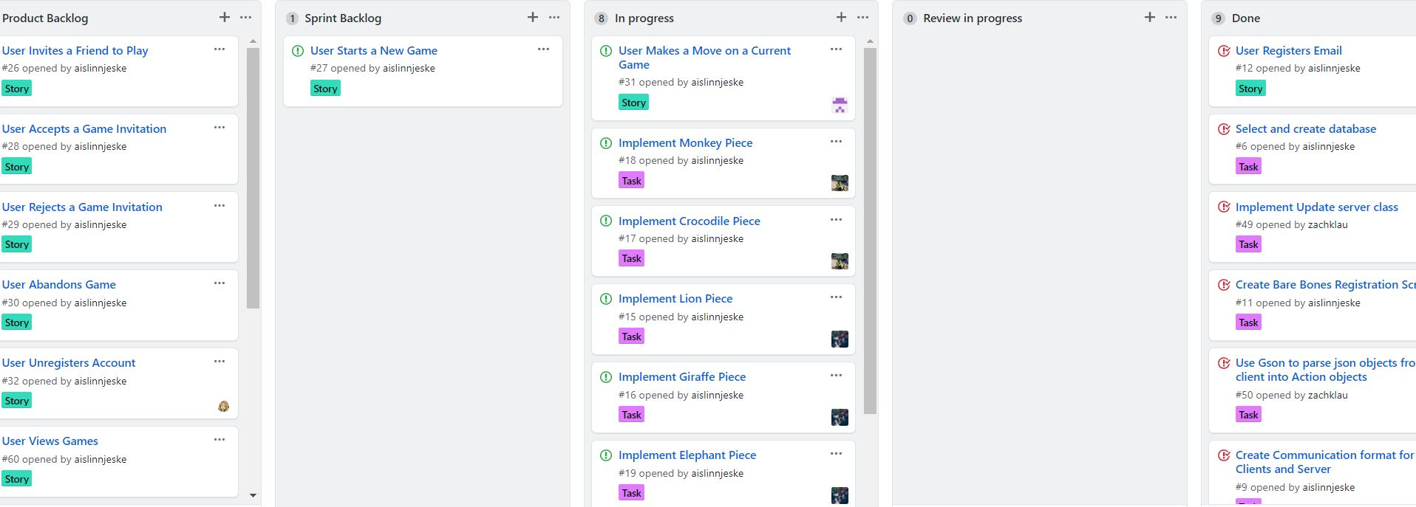
Kanban Board

Slide 10




Tools/Technologies
Slack
GitHub
Google Drive

Slide 11











Tools/Technologies
SASS - Syntactically Awesome Style Sheets
ReactJS
GitHub
JUnit
Travis-CI
Maven, NPM
WebSocket
JSON
IntelliJ
CodeClimate
Java
Jacoco

Slide 12
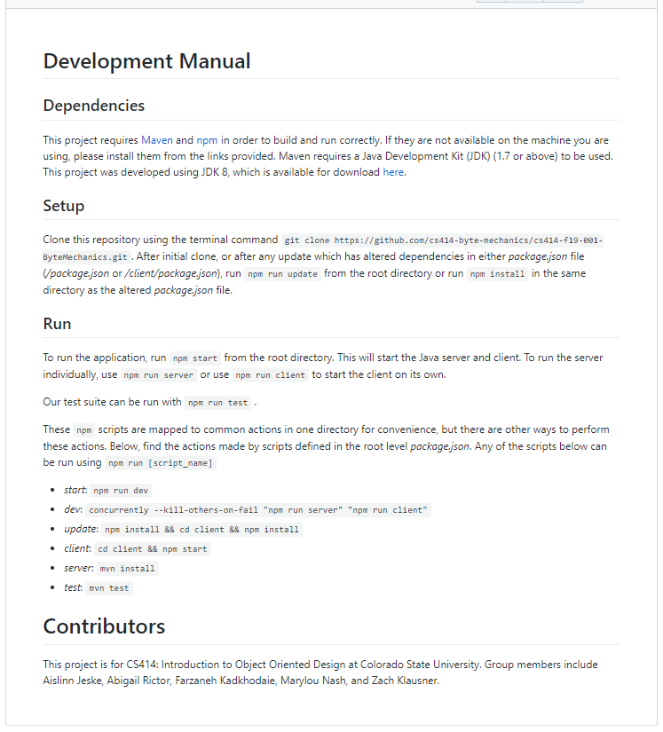
Development Manual
Clone from Byte Mechanic’s GitHub repository
We are using npm and Maven to manage dependencies and builds
Many development and management commands are abstracted by a set of simple npm scripts to streamline use

Slide 13
Review and Retrospective
What work did we commit to being delivered?
Project planning, initial project infrastructure, client-server communication, some board game logic and JUnit testing.
What work did we complete?
We set up project tools such as the GitHub repository, Slack channels, and Travis CI. Planned and documented this process in cards, user stories, class diagrams, etc. Created a Maven project for the server with a corresponding React client infrastructure and a MySQL database. Developed the initial board game logic, client-server and server-database communication and client interface.
What did we do well?
Daily progress, collaboration, communication, short time between PR creation and merging.
What should be focus more on to improve?
More communication with product owner, better planning for
sprint goals, assigning specific teammates to review PRs

Slide 14
Questions?
Thank you!

